Slide 1
Nasarawa GTS Tracking Report - April OBR2 Campaign
Replace with State logo
Day 2
May 3, 2026
Notes:
Remember to add the name of the State

Slide 2
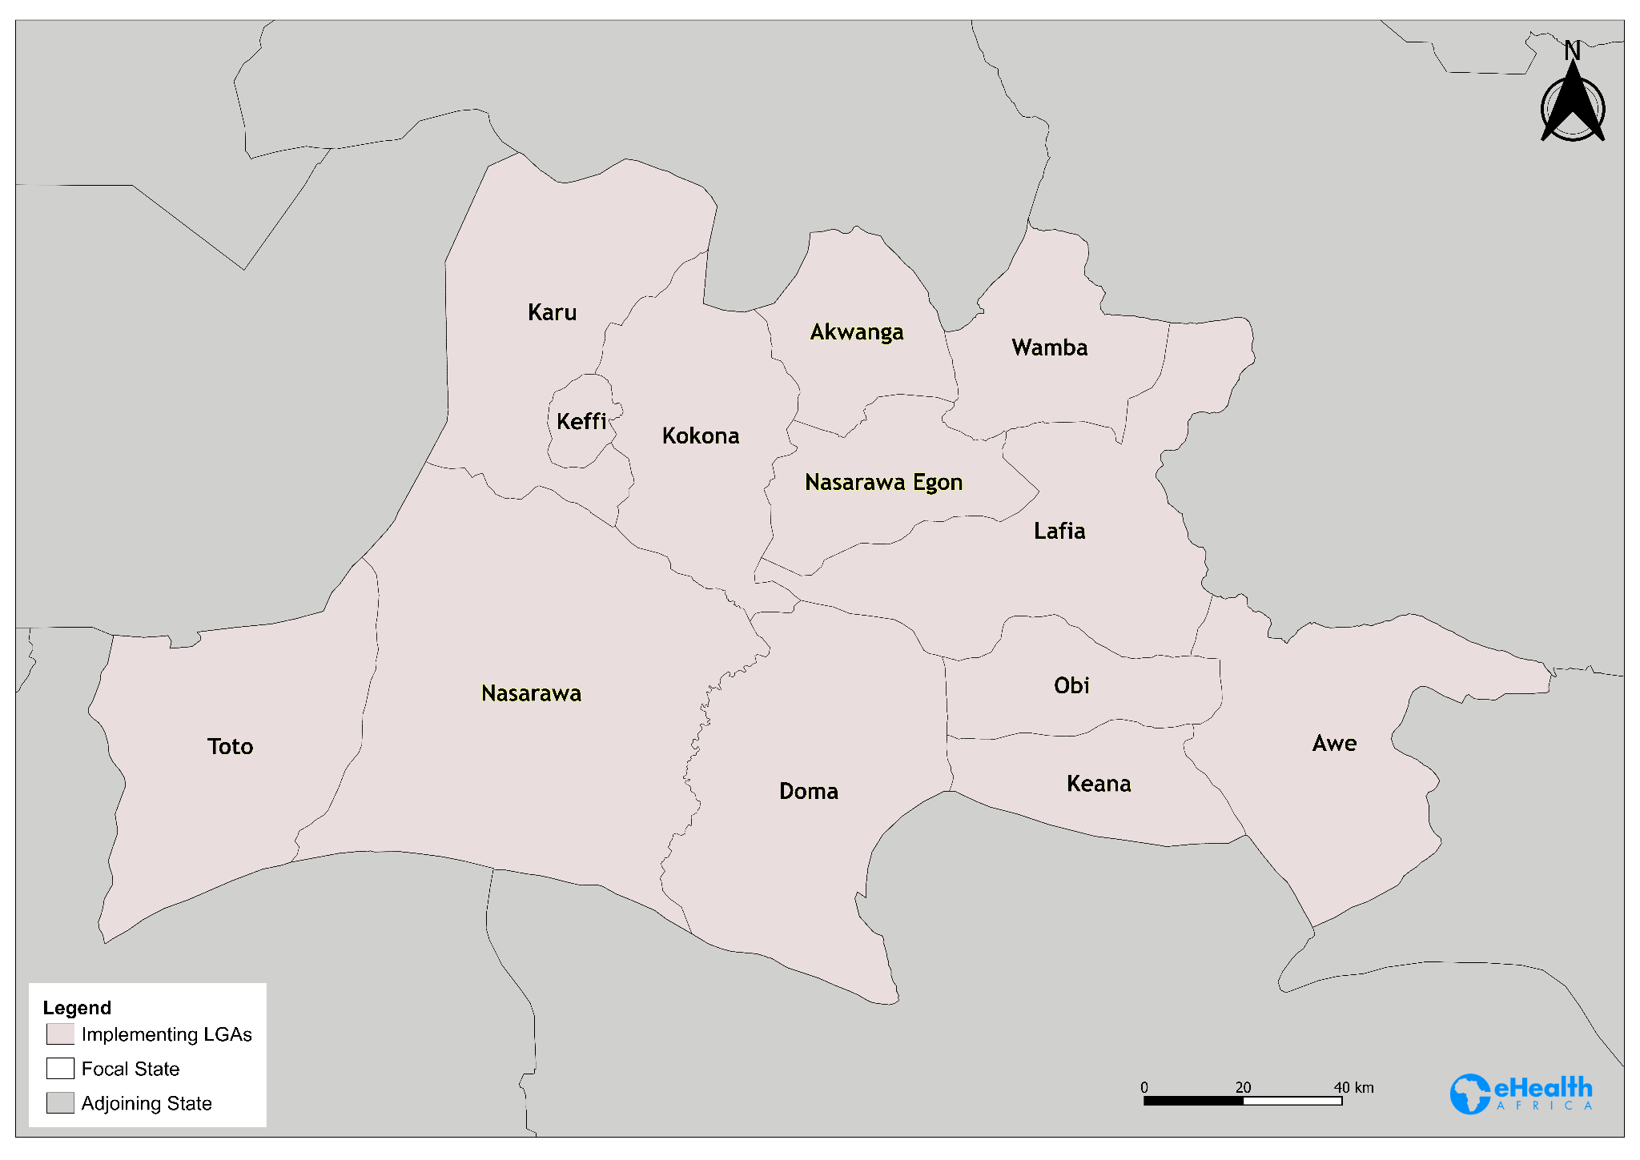
Background
eHealth Africa is supporting the Nasarawa SIPDs campaign with vaccination tracking across the following:
13 LGAs
147 Wards
1,800 vaccination teams are being tracked
7,046 settlements with geo-coordinates across the state are being tracked
8,995 total settlements with and without geo-coordinates planned

Slide 3
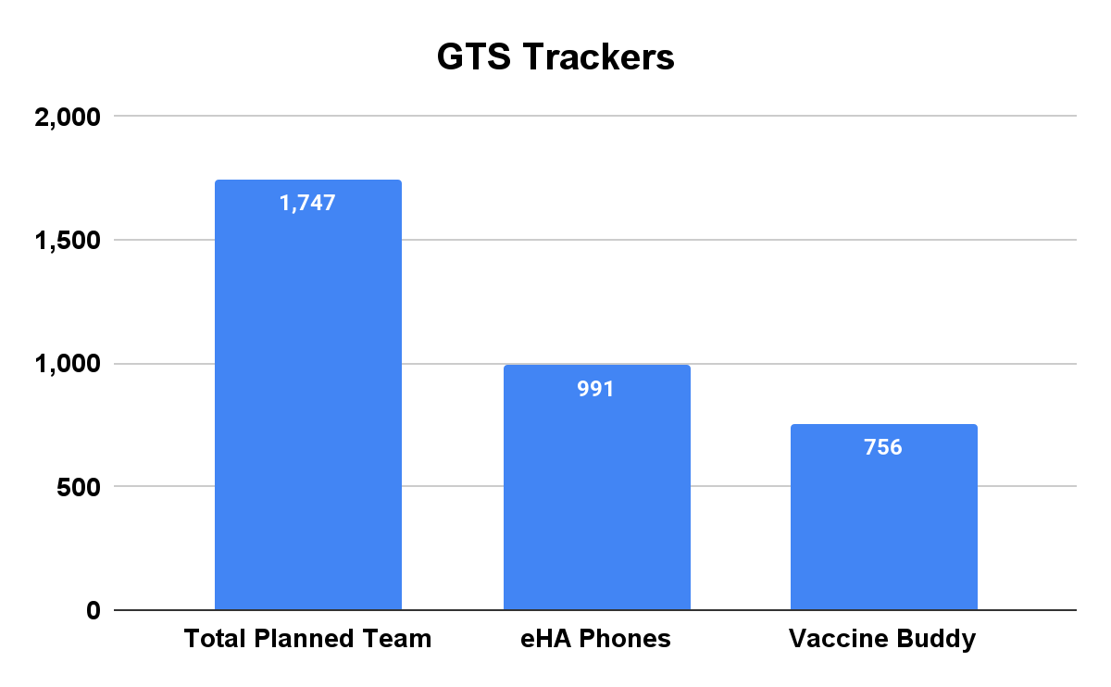
Team Deployed/Team Reported
1747 Teams were deployed and 887 have reported as at 3:00 PM of generating this report with 860 teams pending.

Slide 4
Team Time Efficiency
Teams plotted by time in the field against grid-weighted coverage. Teams logging more than 2 hours with under 50% of their assigned grid covered are flagged, as are teams whose tracks never left a single grid cell.

Slide 5
Tracking Sessions by Team & Device
Tracking sessions per team and per device for the reporting day. Teams and devices are ranked with shared devices first: a device transmitting under more than one team code invalidates both teams' tracks.

Slide 6
Tracks per Device (IMEI) by LGA
Unique devices, tracks and pings per LGA, with each device attributed to the LGA its GPS points fall inside. Devices are identified by IMEI, so repeated submissions from one handset are counted once.

Slide 7
Tracks per Team Code by LGA
Unique team codes, tracks and pings per LGA, with each team attributed to the LGA its GPS points fall inside. A team that worked more than one LGA appears in each, so the column sums above the state total.

Slide 8
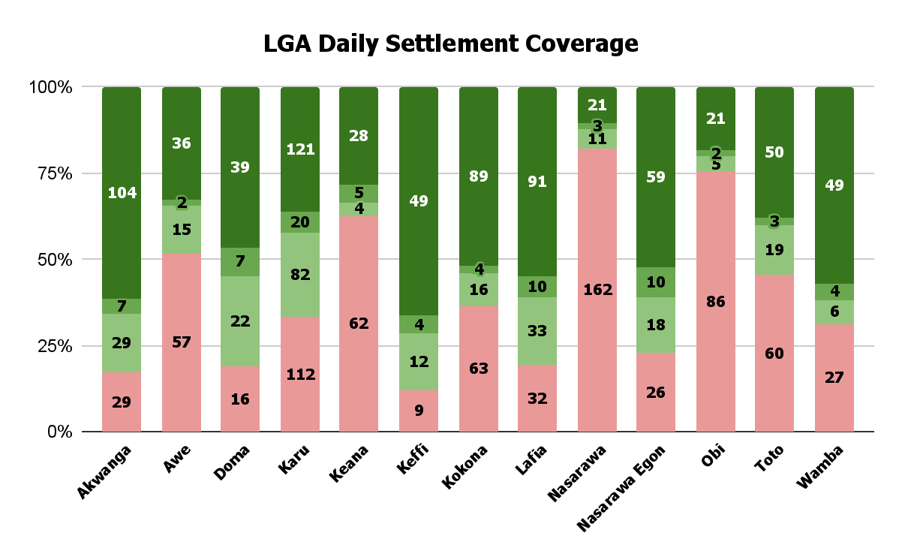
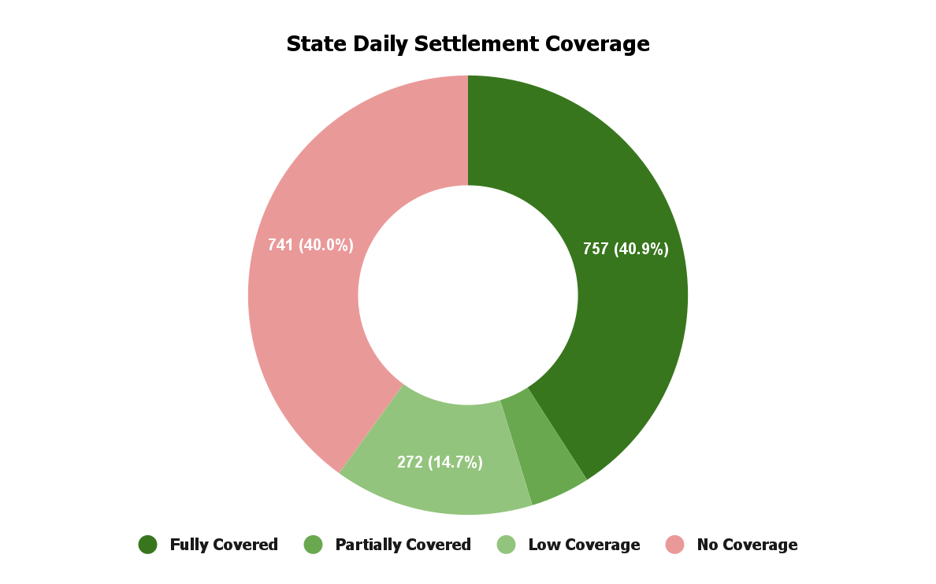
State Daily Coverage - Day 2
1,110 (59.97%) of the 1,851 settlements planned for Day 2 with geo-coordinates were visited across the 13 LGAs.
469 (6.2%)
1,851

Slide 9
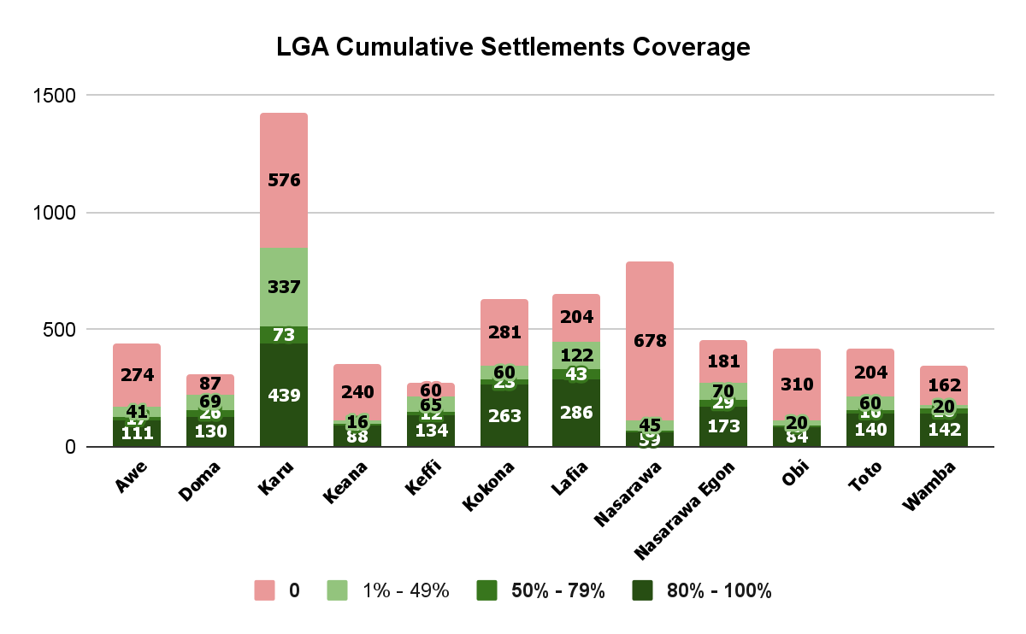
Cumulative Coverage by LGA - Day 2
3,608 (51.2%) of the 7,046 cumulative settlements planned with geo-coordinates were visited across the 13 LGAs on Day 2.

Slide 10
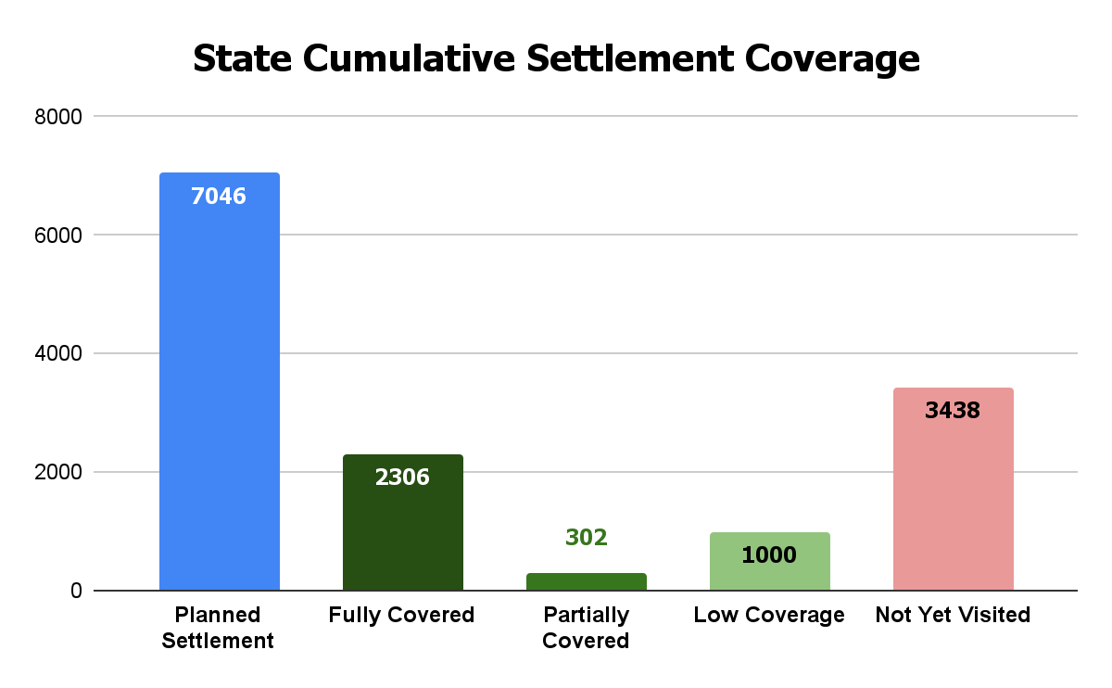
Cumulative Settlements Coverage
3,608 (51.2%) of the 7,046 cumulative settlements planned with geo-coordinates were visited across the 13 LGAs on Day 2.

Slide 11
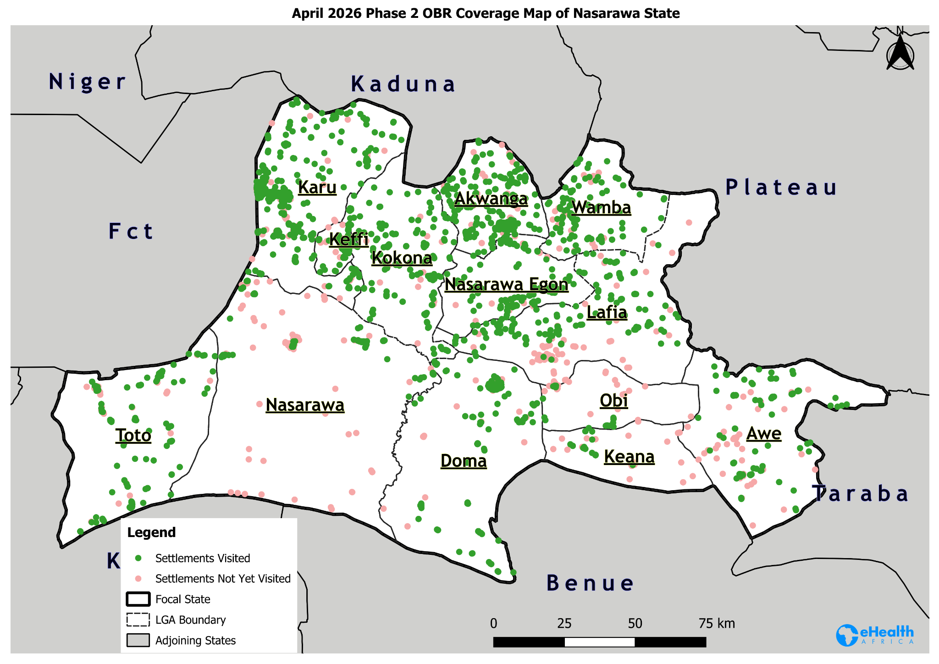
State Coverage Map - Day 2

Slide 12
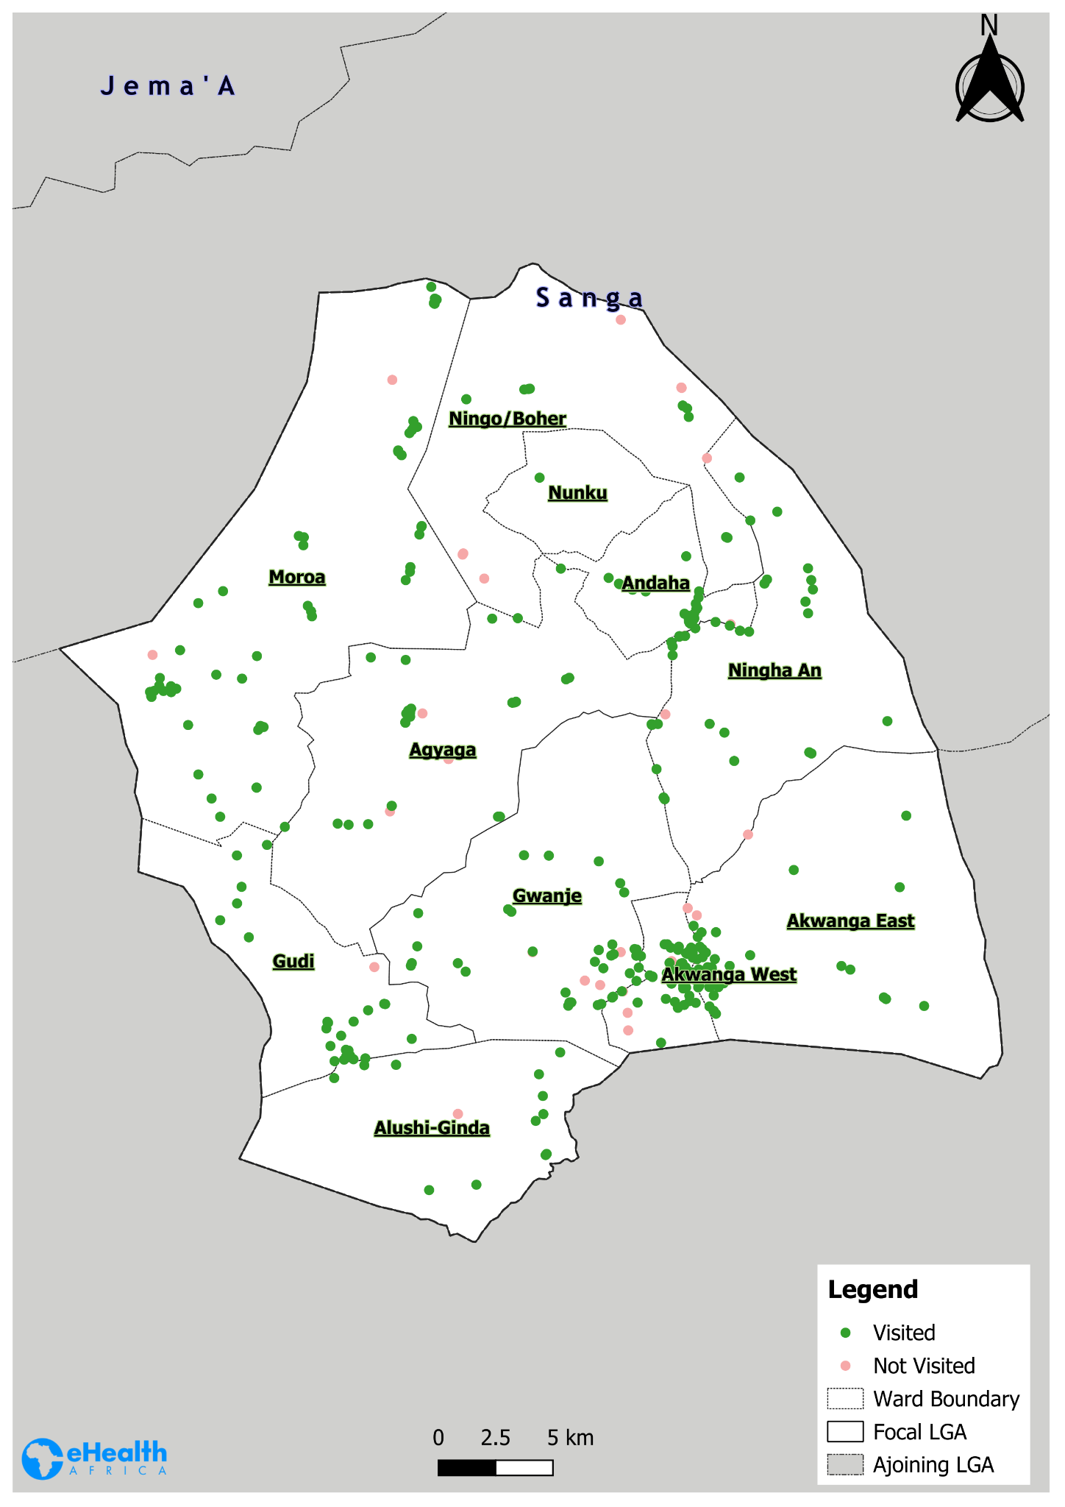
Akwanga LGA Coverage Map - Day 2

Slide 13
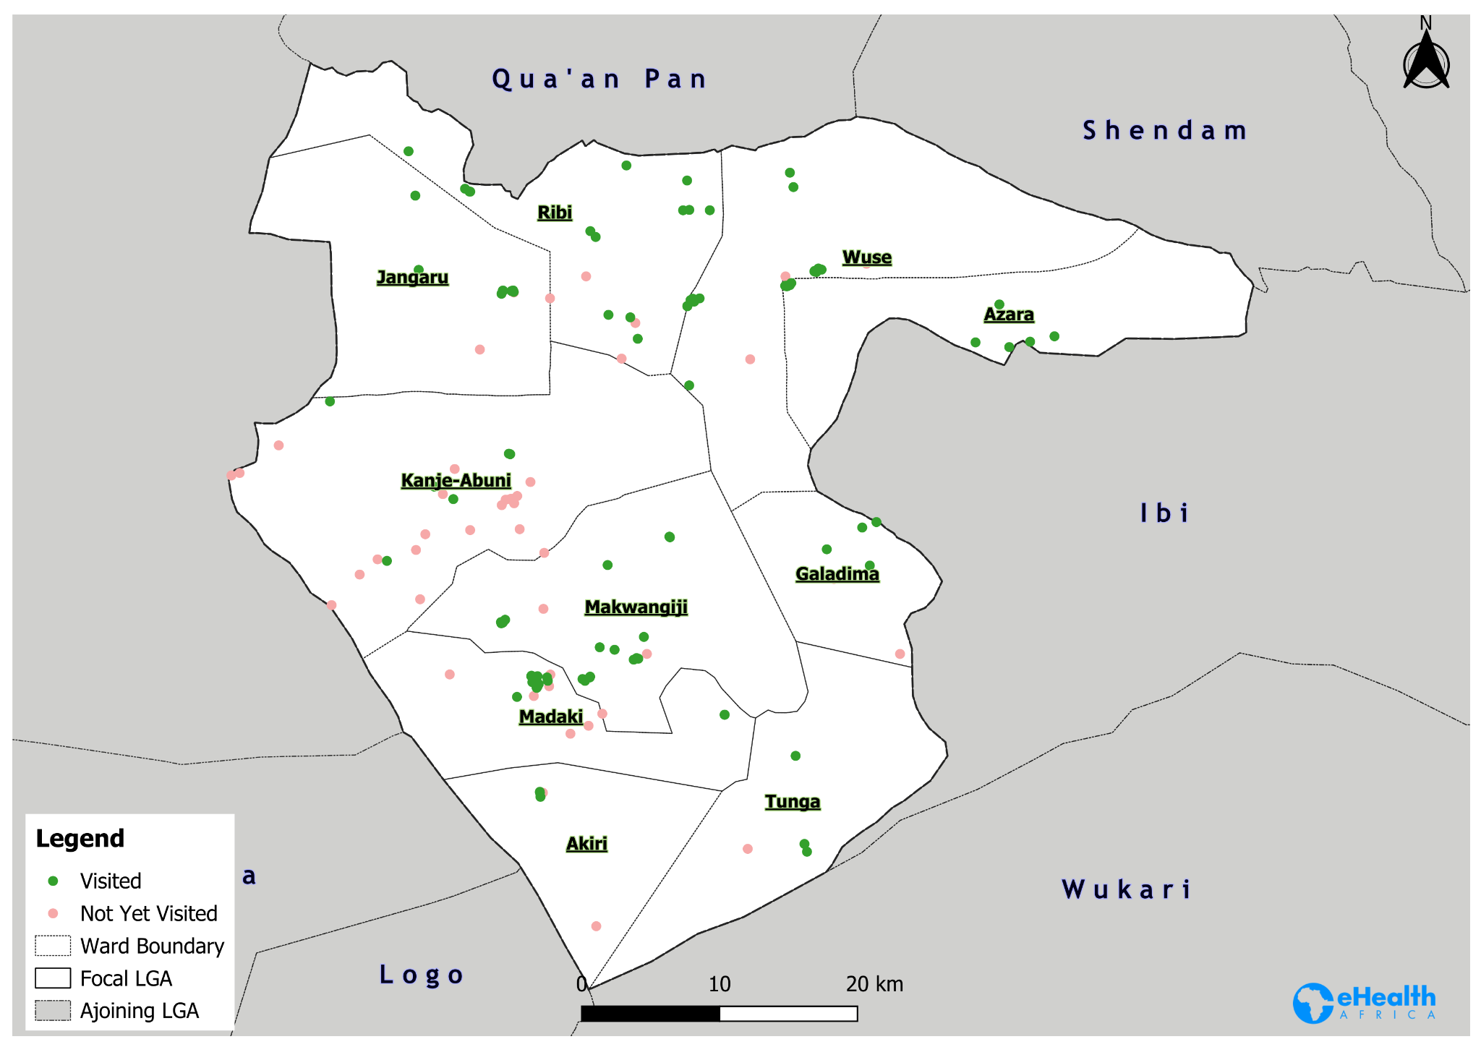
Awe LGA Coverage Map - Day 2

Slide 14
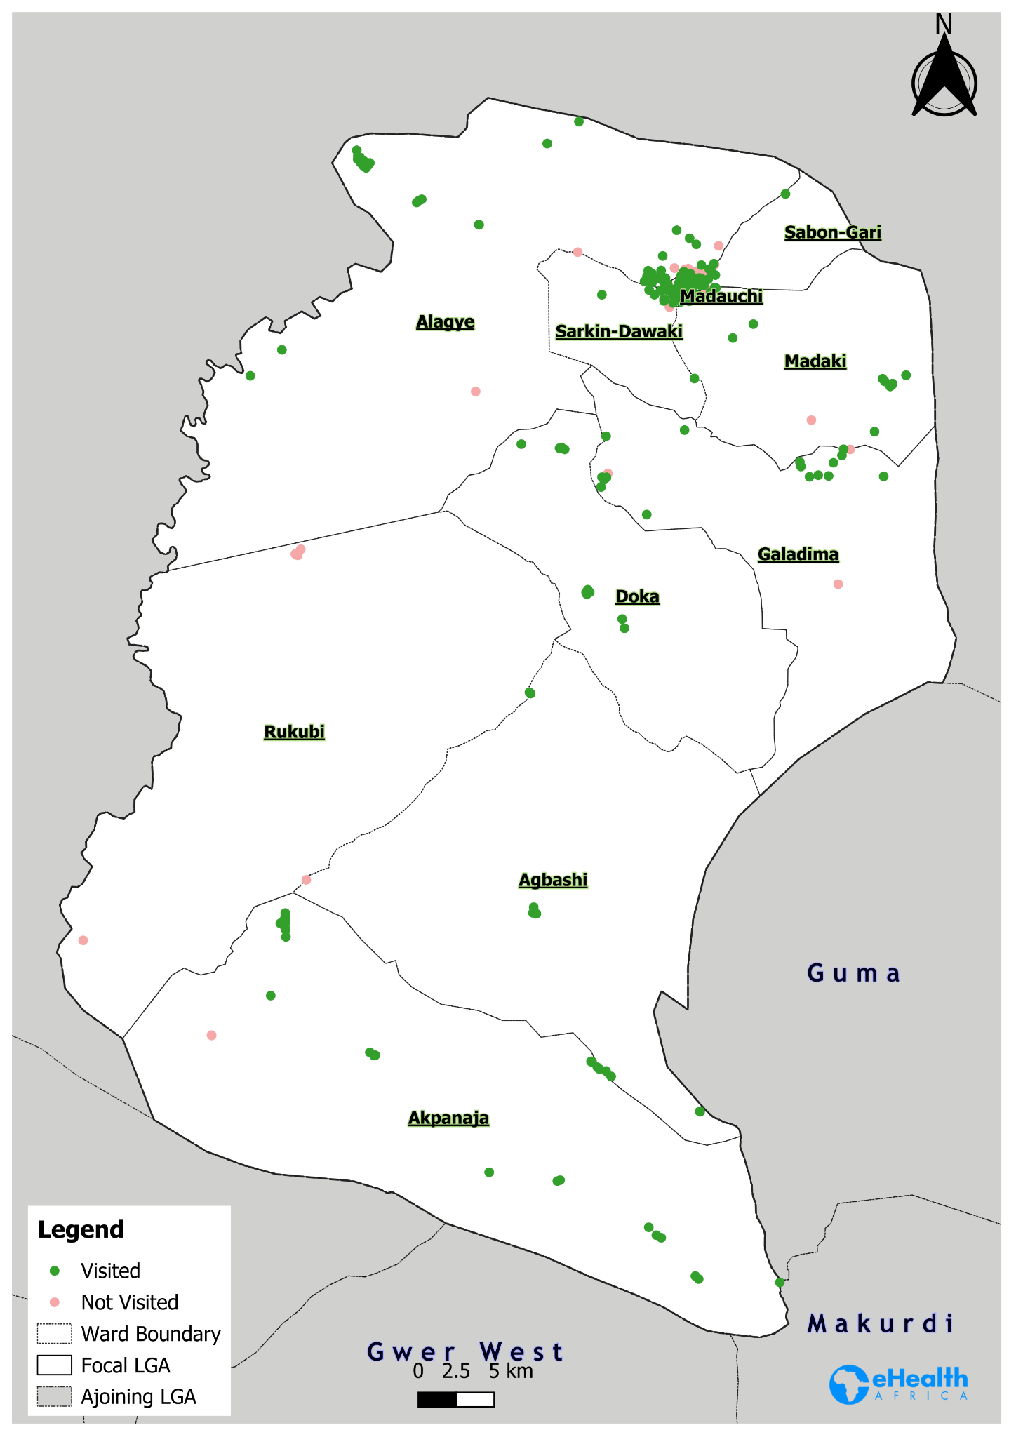
Doma LGA Coverage Map - Day 2

Slide 15
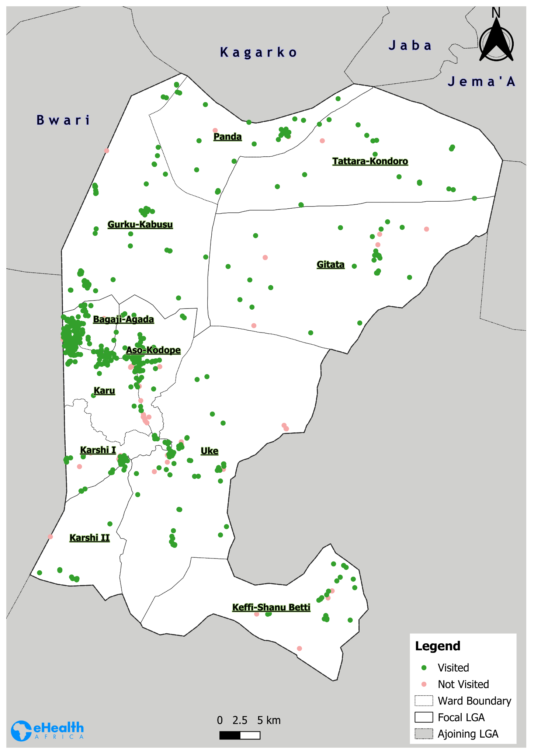
Karu LGA Coverage Map - Day 2

Slide 16
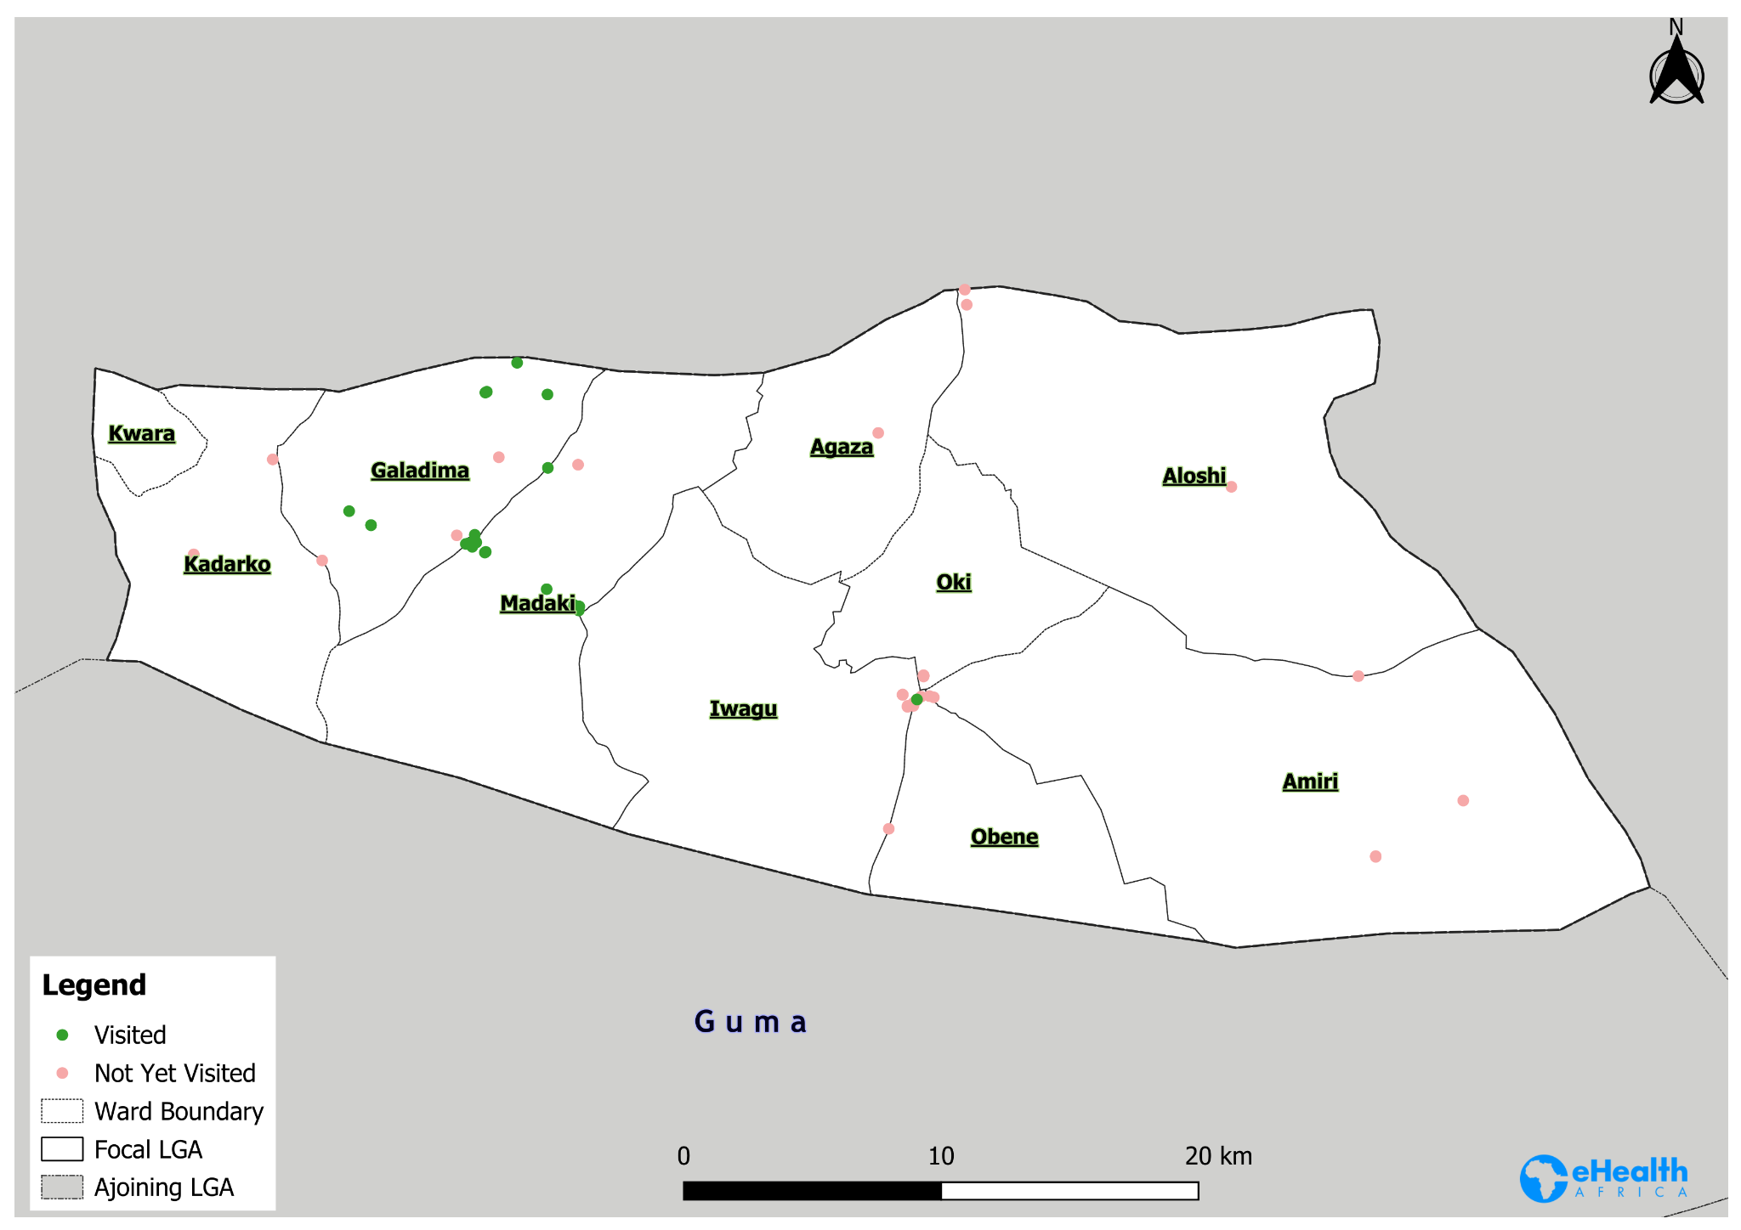
Kaena LGA Coverage Map - Day 2

Slide 17
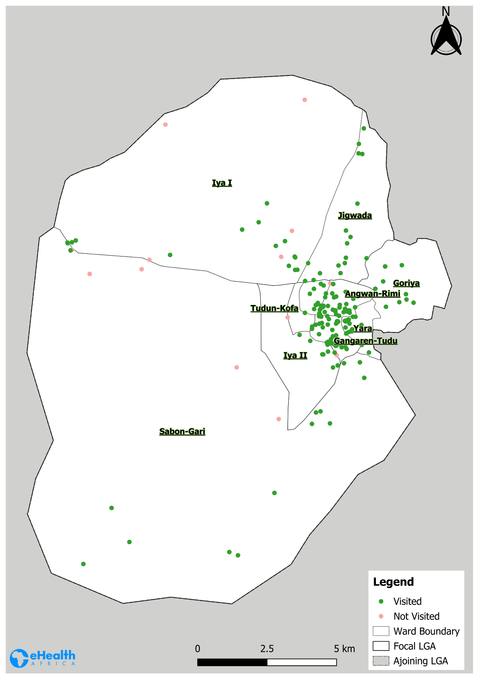
Keffi LGA Coverage Map - Day 2

Slide 18
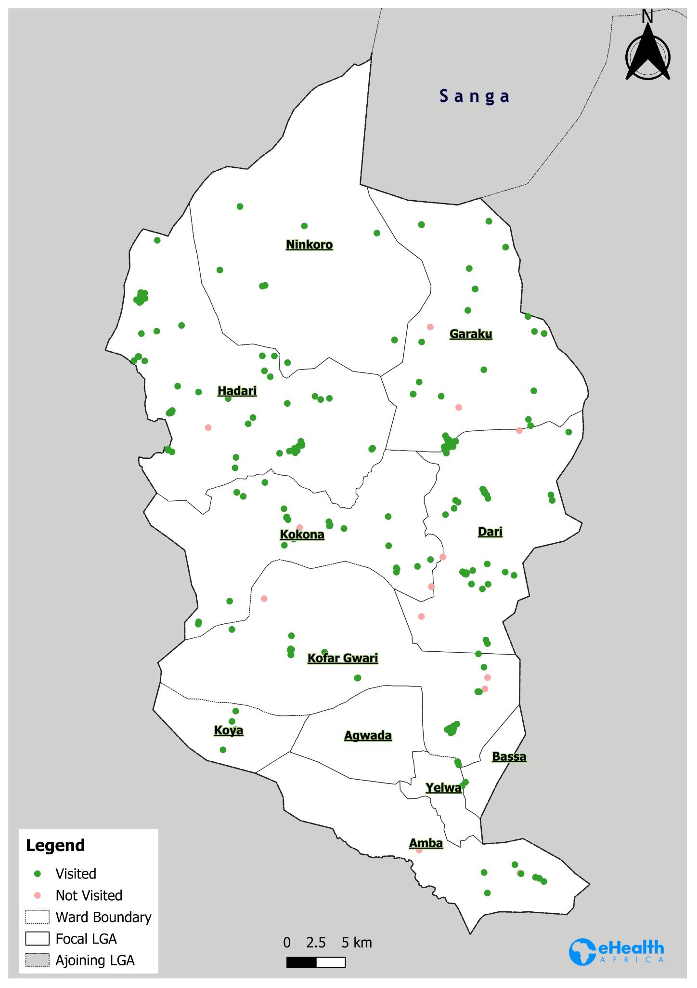
Kokona LGA Coverage Map - Day 2

Slide 19
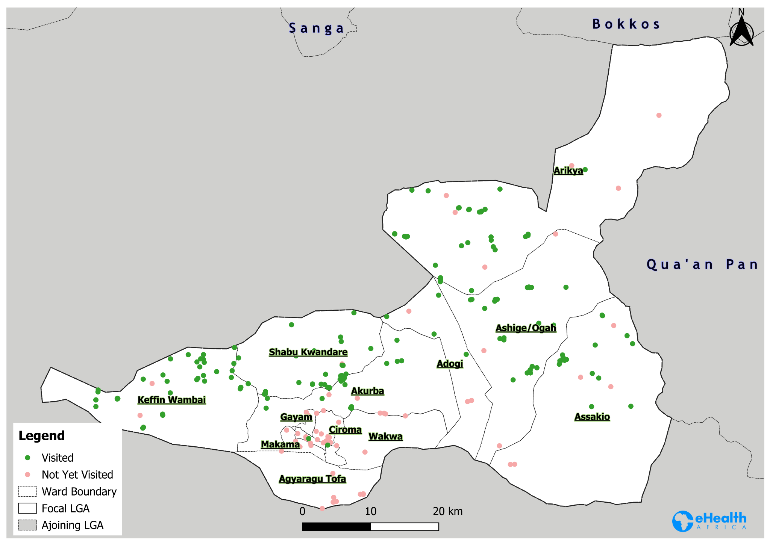
Lafia LGA Coverage Map - Day 2

Slide 20
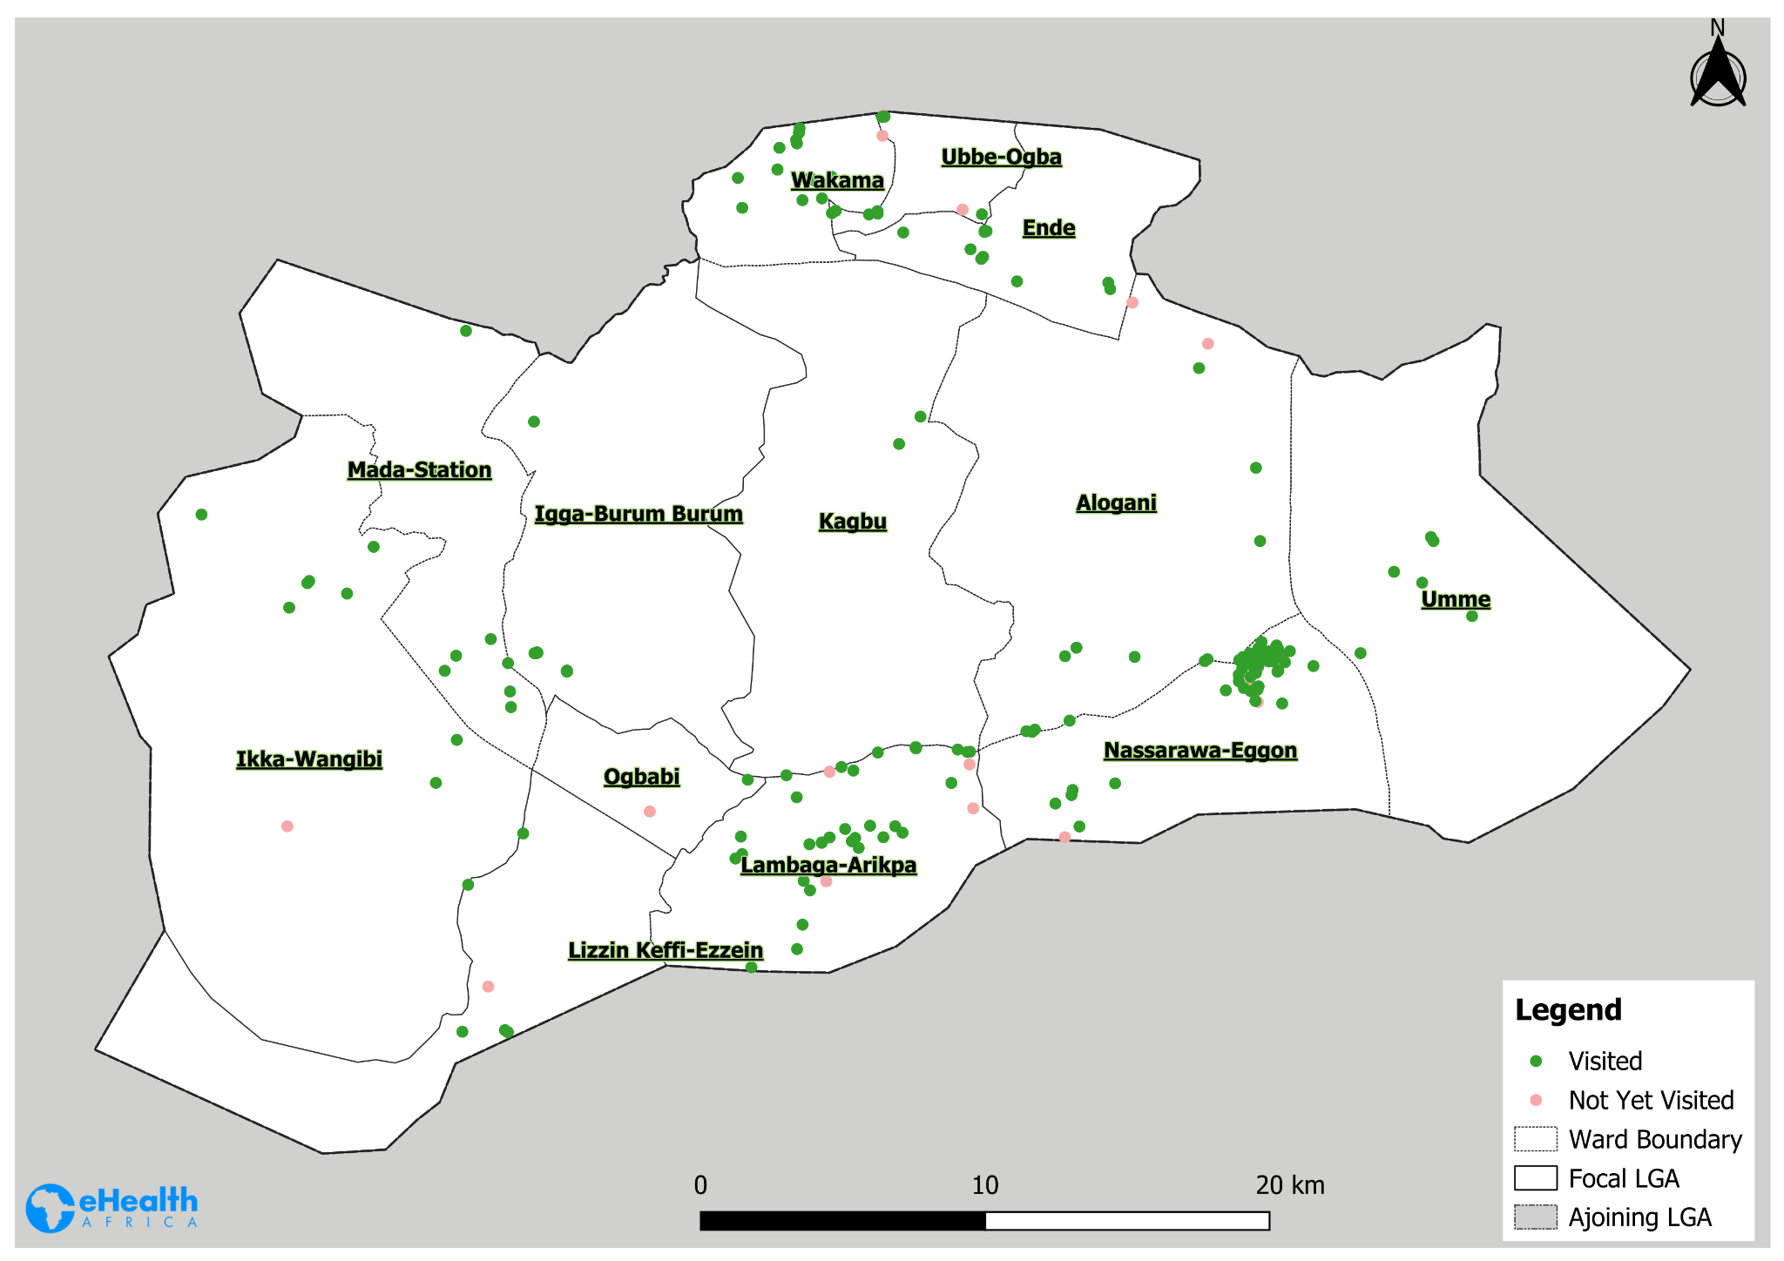
Nasarawa Egon LGA Coverage Map - Day 2

Slide 21
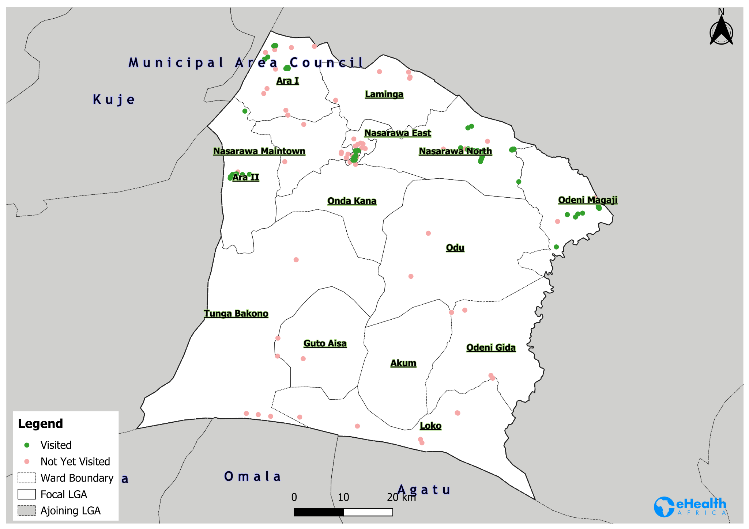
Nasarawa LGA Coverage Map - Day 2

Slide 22
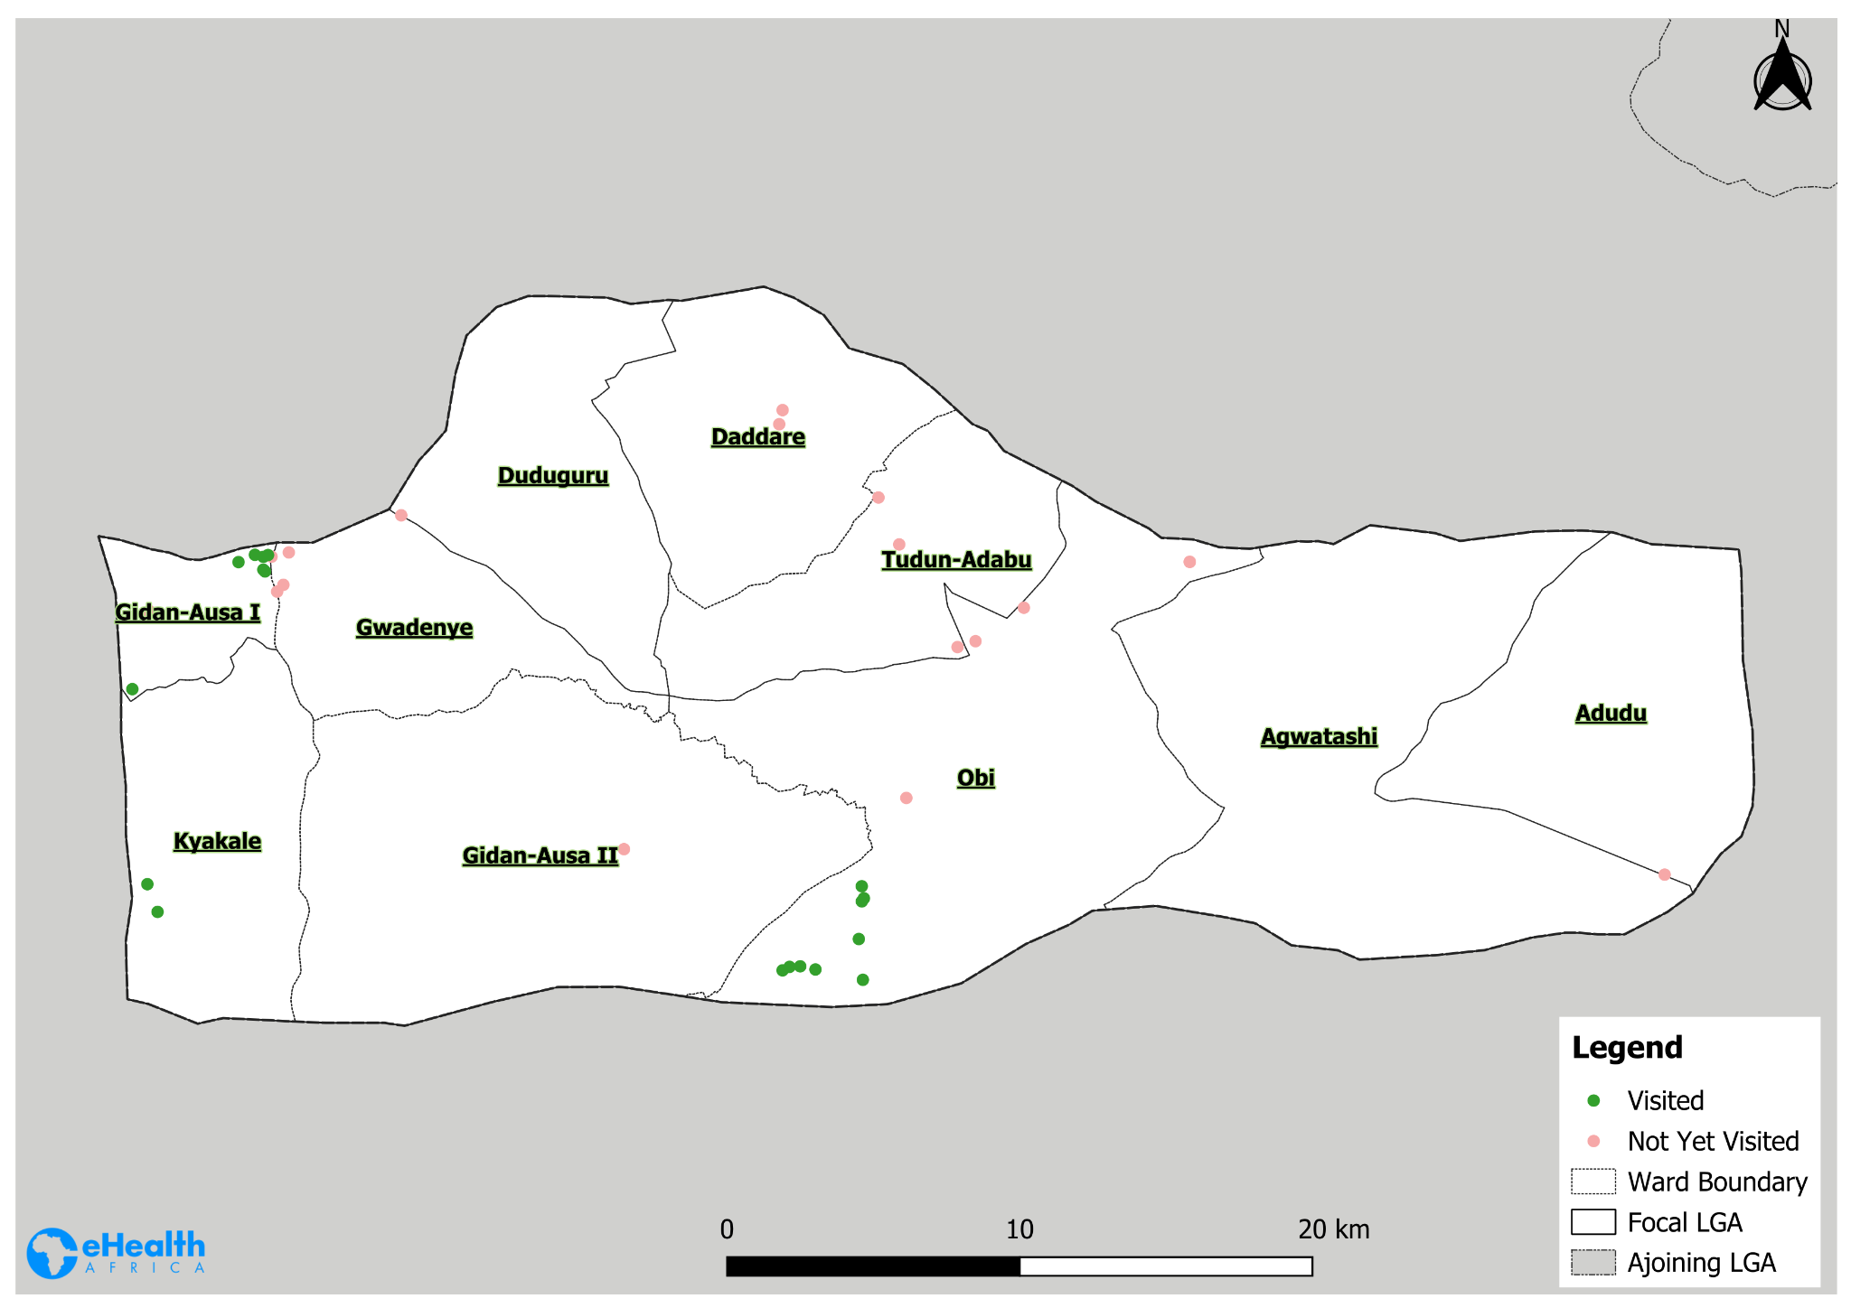
Obi LGA Coverage Map - Day 2

Slide 23
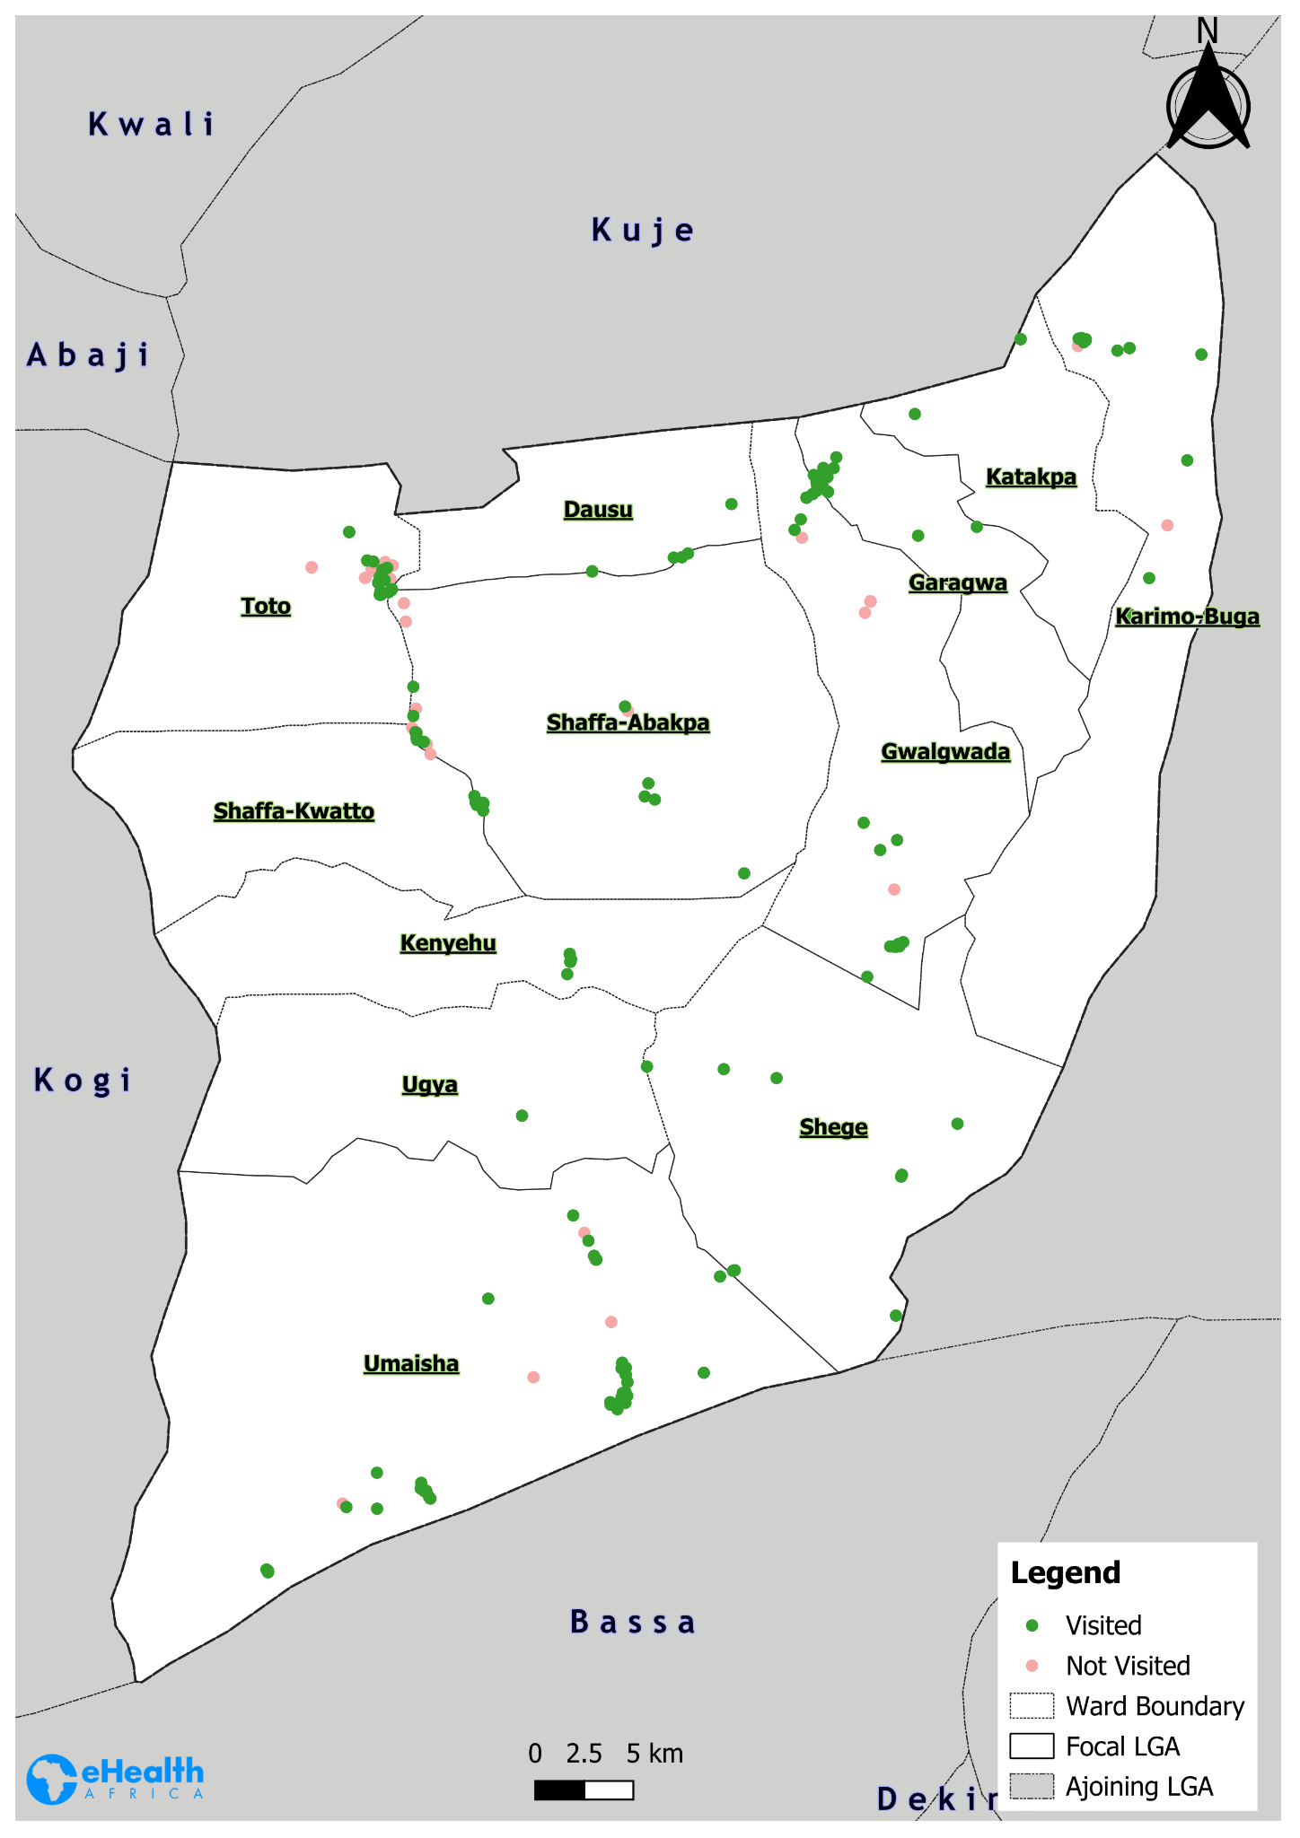
Toto LGA Coverage Map - Day 2

Slide 24
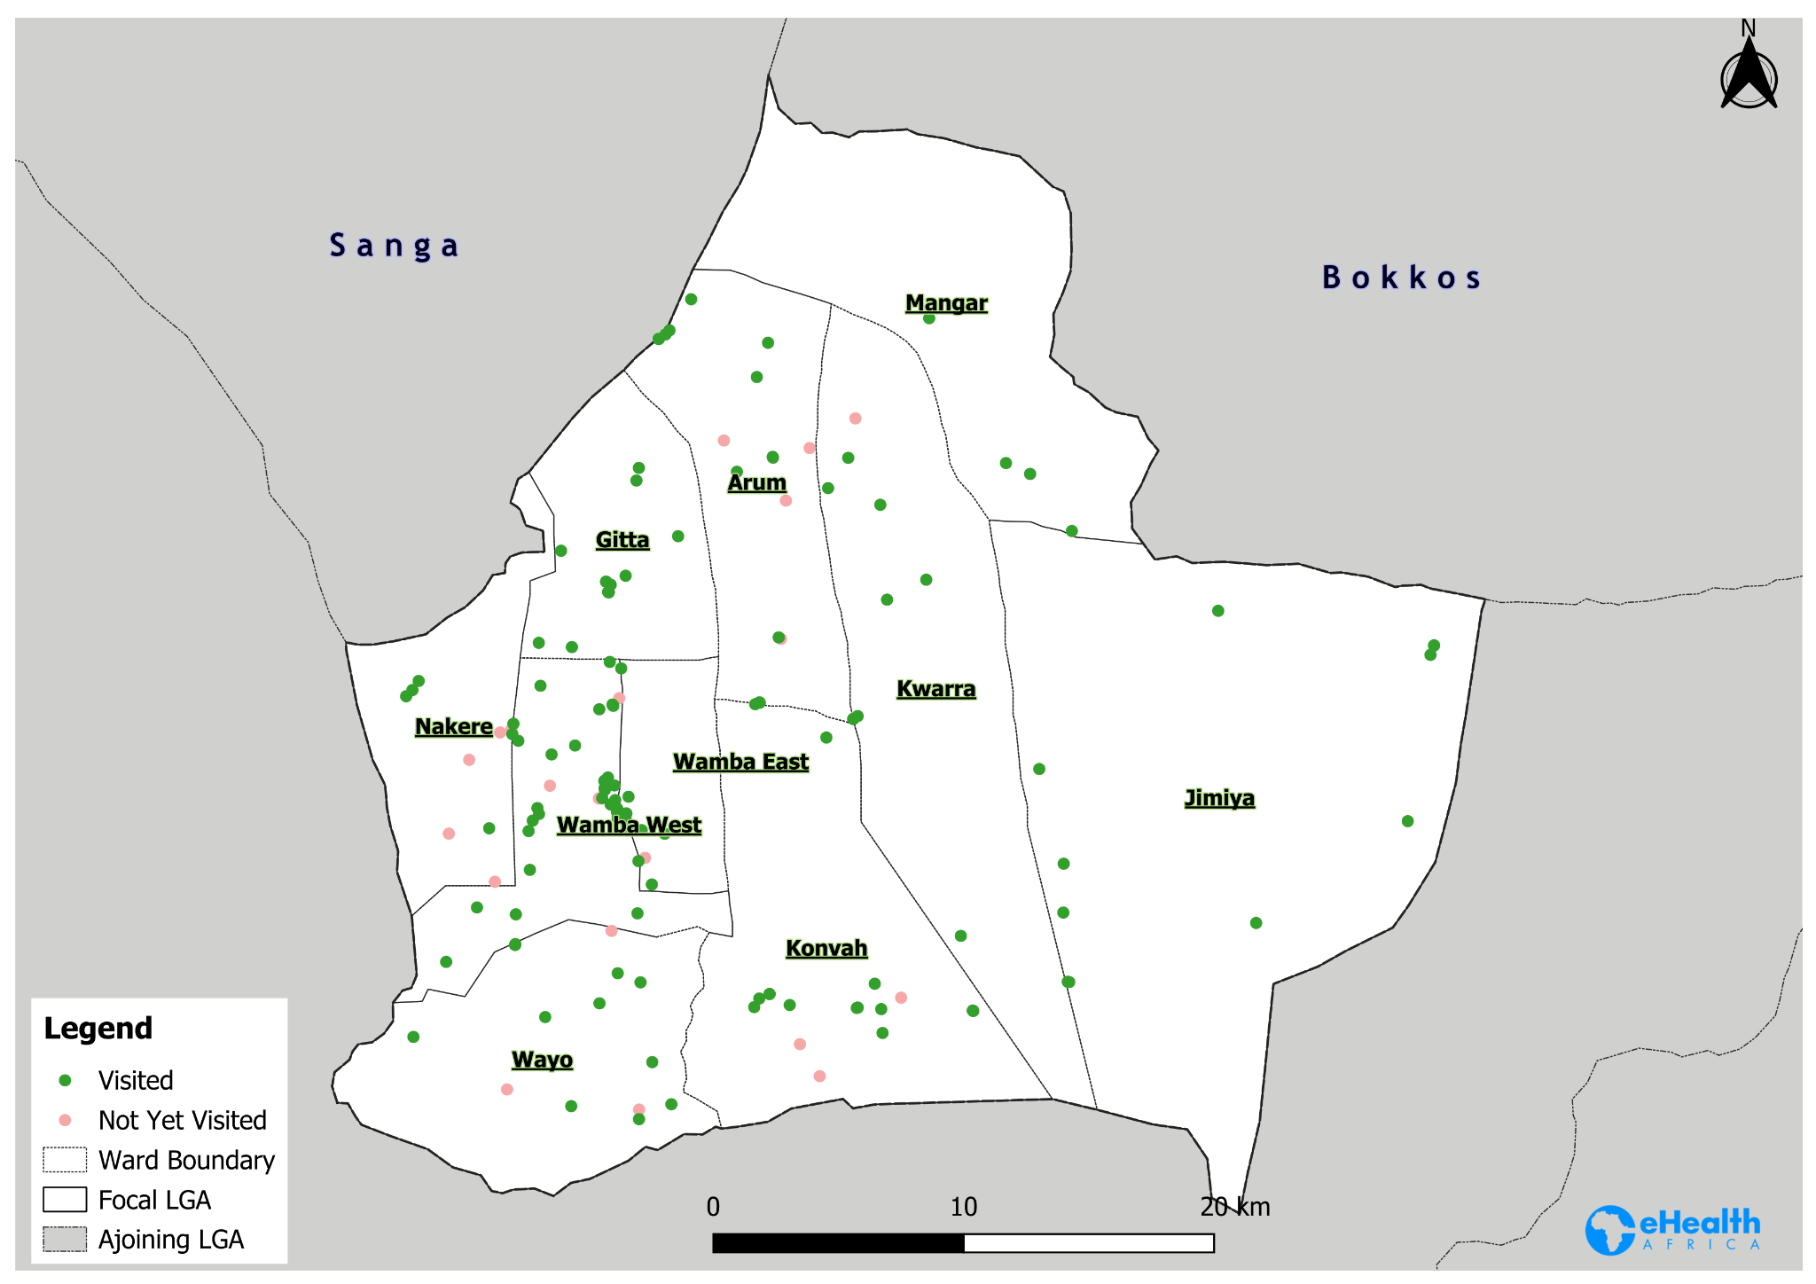
Wamba LGA Coverage Map - Day 2

Slide 25
Challenges
Late return of trackers from the field due to far distance as such delays data upload and synchronization to the server.
Poor network connectivity causes delay is data uploads.
GTS dashboard under maintenance from the NPHCDA, hence analysis could not be accessed.
Team 061 of kokona ward didn’t use the tracker.

Slide 26
Deployment Pictures
eHealth staff distributing the trackers during the morning takeoffs at the implementing LGAs

Slide 27
Supportive Supervision Pictures
eHealth staff providing supportive supervision in the implementing LGAs

Slide 28
Thank you!

